Slide 1
Test Cases for Combustion Chemistry in a Isobaric Reactor
Simone Venturi, Tiernan Casey
Extreme-Scale Data Science & Analytics (8739)

Slide 2
A Combustion Chemistry in Isobaric Reactor Test Case
Initial conditions
Isobaric 0-D Reactor (Hydrogen-air), 20 state variables
(i.e., temperature and 19 species mass fractions)
Some training scenarios
The physical system is implemented in
$WORKSPACE_PATH/ROMNet/romnet/romnet/pinn/system/0DReact.py

Slide 3
A Combustion Chemistry in Isobaric Reactor Test Case
Initial conditions
Isobaric 0-D Reactor (Hydrogen-air), 20 state variables
(i.e., temperature and 19 species mass fractions)
Note:
Similitudes with
translating hyperbolic tangent
Some training scenarios
The physical system is implemented in
$WORKSPACE_PATH/ROMNet/romnet/romnet/pinn/system/0DReact.py

Slide 4
A Combustion Chemistry in Isobaric Reactor Test Case
Run python scrip:
$WORKSPACE_PATH/ROMNet/romnet/scripts/generating_data/0DReactor/Generate_Data_1_Isobaric.py
for generating simulation data
Note: The script needs to be run twice, the second time for generating test data
Run Jupyter Notebook:
$WORKSPACE_PATH/ROMNet/romnet/scripts/generating_data/0DReactor/Generate_Data_3_Isobaric.ipynb
for generating training and test data

Slide 5
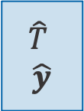

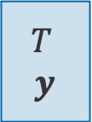

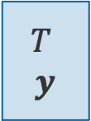
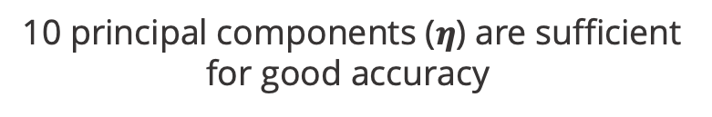
A Combustion Chemistry in Isobaric Reactor Test Case
Employed PCA for reducing the
dimensionality of the state space
$$T$$
$$y$$
PCA
$$η$$
$$T$$
$$y$$
PCA
$$η$$
PCA⁻¹
$$\hat{T}$$
$$\hat{y}$$
10 principal components ($η$) are sufficient for good accuracy

Slide 6
A Combustion Chemistry in Isobaric Reactor Test Case
Run python scrip:
$WORKSPACE_PATH/ROMNet/romnet/scripts/generating_data/0DReactor/Generate_Data_2_Isobaric.py
for generating PCA simulation data
Note: The script needs to be run twice, the second time for generating test data
Run Jupyter Notebook:
$WORKSPACE_PATH/ROMNet/romnet/scripts/generating_data/0DReactor/Generate_Data_4_Isobaric.ipynb
for generating PCA training and test data

Slide 7
A Combustion Chemistry in Isobaric Reactor Test Case
Test Case 9

Slide 8
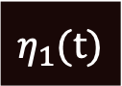
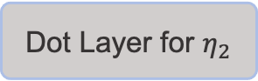
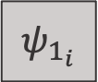
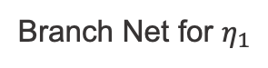
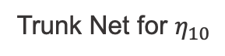
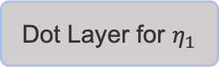
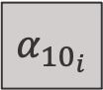
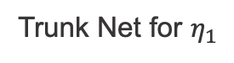
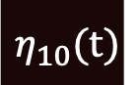
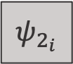
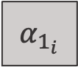
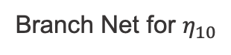
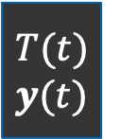
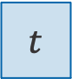
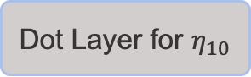
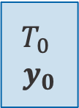
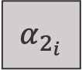
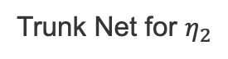
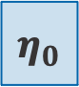
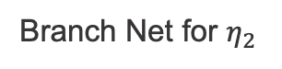
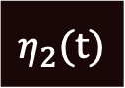
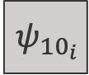
A Combustion Chemistry in Isobaric Reactor Test Case
Branch Net for $η_{1}$
$$α_{1_{i}}$$
Branch Net for $η_{2}$
$$α_{2_{i}}$$
DeepONet Structure
$$T_{0}$$
$$y_{0}$$
PCA
$$η_{0}$$
…
…
Branch Net for $η_{10}$
$$α_{{10}_{i}}$$
Dot Layer for $η_{1}$
$$η_{1}(t)$$
Dot Layer for $η_{2}$
$$η_{2}(t)$$
PCA⁻¹
$$T(t)$$
$$y(t)$$
…
…
Trunk Net for $η_{1}$
$$ψ_{1_{i}}$$
$$ψ_{2_{i}}$$
Dot Layer for $η_{10}$
$$η_{10}(t)$$
Trunk Net for $η_{2}$
$$t$$
…
…
Note: The linear (anti-)transformations PCA⁻¹ and PCA are precomputed offline (i.e., they are not trained with the DeepONet)
Trunk Net for $η_{10}$
$$ψ_{{10}_{i}}$$

Slide 9
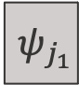

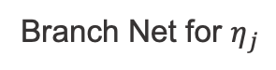


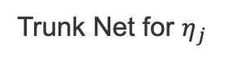
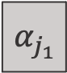
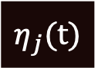

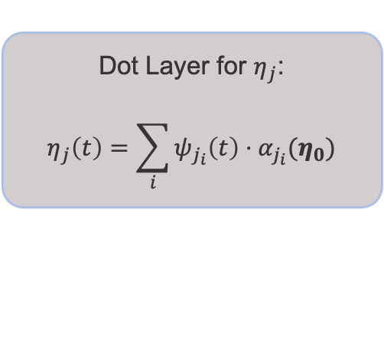
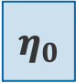
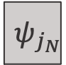
A Combustion Chemistry in Isobaric Reactor Test Case
Branch Net for $η_{j}$
$$α_{j_{1}}$$
Part of the DeepONet Structure
Corresponing to the
j-th Principal Component
$$η_{0}$$
64, Tanh
64, Tanh
64, Tanh
N, Linear
$$…$$
$$α_{j_{N}}$$
Dot Layer for $η_{j}$:
$$η_{j}\left(t\right)=\sum_{i}{ψ_{j_{i}}\left(t\right)⋅α_{j_{i}}(η_{0})}$$
$$η_{j}(t)$$
$$ψ_{j_{1}}$$
Trunk Net for $η_{j}$
64, Tanh
64, Tanh
64, Tanh
N, Linear
$$…$$
$$t$$
$$ψ_{j_{N}}$$
After being trained (even with large number of data and large number of neurons, N), the DeepONet generates highly oscillatory predictions

Slide 10
A Combustion Chemistry in Isobaric Reactor Test Case
Test Case 9: Data-driven deep operator network (DeepONet) for predicting Principal Components
9.1. Copy $WORKSPACE_PATH/ROMNet/romnet/input/0DReact/DeepONet/TestCase9/ROMNet_Input.py
to $WORKSPACE_PATH/ROMNet/romnet/input/ROMNet_Input.py
9.2. In $WORKSPACE_PATH/ROMNet/romnet/input/ROMNet_Input.py, change:
9.2.1. "self.WORKSPACE_PATH = ..."
9.3. Move to $WORKSPACE_PATH/ROMNet/romnet/app/
9.4. Run: "python3 ROMNet.py ../input/”
9.5. Postprocess results via: $WORKSPACE_PATH/ROMNet/romnet/scripts/postprocessing/0DReact/DeepONet/Predict_DeepONet.ipynb

Slide 11
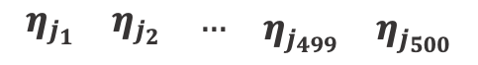
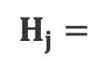

A Combustion Chemistry in Isobaric Reactor Test Case
Investigating the issue: a principal component analysis
Aggregation of training scenarios for $η_{j}\left(t\right)$, where $j$ represents the scenario index:
$$Η_{j}=$$
$$\begin{matrix}\begin{matrix}η_{j_{1}} & η_{j_{2}} & …\end{matrix} & η_{j_{499}} & η_{j_{500}}\end{matrix}$$
$$dim\left(Η_{j}\right)={N_{t} × N}_{s}$$
No. time
instants
No. of
scenarios

Slide 12
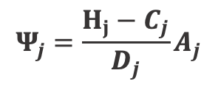
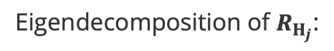
A Combustion Chemistry in Isobaric Reactor Test Case
$$Ψ_{j}=\frac{Η_{j}−C_{j}}{D_{j}}A_{j}$$
Eigendecomposition of $R_{Η_{j}}$:
(Note: results are shown for $j=1$ (i.e., for $η_{1}$))
A relatively large number of modes needs to be preserved in order to predict $η_{j}$with good accuracy

Slide 13
A Combustion Chemistry in Isobaric Reactor Test Case
Low energy modes are highly oscillatory and hard to be learnt by the DeepONet’s trunk nets

Slide 14
A Combustion Chemistry in Isobaric Reactor Test Case
Run Jupyter Notebook:
$WORKSPACE_PATH/ROMNet/romnet/scripts/generating_data/0DReactor/Generate_Data_5.ipynb
for generating PCA data

Slide 15
A Combustion Chemistry in Isobaric Reactor Test Case
Test Case 10

Slide 16
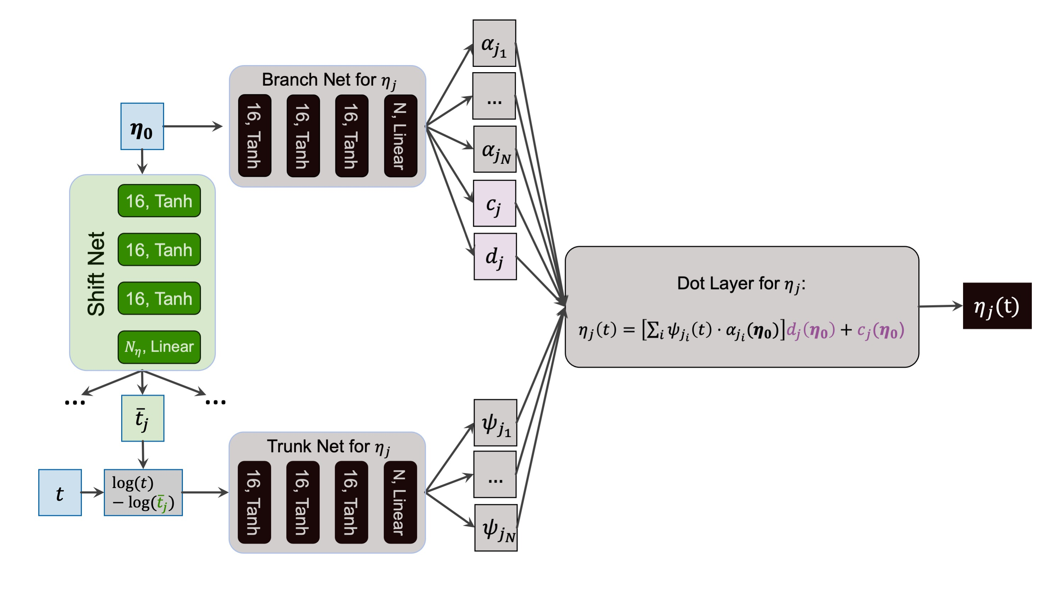
A Combustion Chemistry in Isobaric Reactor Test Case
Suggested Improved Structure
for the DeepONet

Slide 17
A Combustion Chemistry in Isobaric Reactor Test Case
Results from the improved structure
Predicted time-dependent principal components for test scenarios

Slide 18
A Combustion Chemistry in Isobaric Reactor Test Case
Results from the improved structure
Reconstructed time-dependent temperature and species for test scenarios

Slide 19
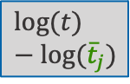
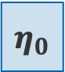
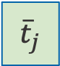


A Combustion Chemistry in Isobaric Reactor Test Case
Results from the improved structure
$$η_{0}$$
16, Tanh
Shift Net
16, Tanh
16, Tanh
$N_{η}$, Linear
…
…
$${\overline{t}}_{j}$$
$$t$$
$$log⁡(t)−log⁡({\overline{t}}_{j})$$

Slide 20
A Combustion Chemistry in Isobaric Reactor Test Case
Test Case 10: Data-driven improved deep operator network (DeepONet) for predicting Principal Components
10.1. Copy $WORKSPACE_PATH/ROMNet/romnet/input/0DReact/DeepONet/TestCase10/ROMNet_Input.py
to $WORKSPACE_PATH/ROMNet/romnet/input/ROMNet_Input.py
10.2. In $WORKSPACE_PATH/ROMNet/romnet/input/ROMNet_Input.py, change:
10.2.1. "self.WORKSPACE_PATH = ..."
10.3. Move to $WORKSPACE_PATH/ROMNet/romnet/app/
10.4. Run: "python3 ROMNet.py ../input/”
10.5. Postprocess results via: $WORKSPACE_PATH/ROMNet/romnet/scripts/postprocessing/0DReact/DeepONet/Predict_DeepONet.ipynb

